Slide 1
Friday Night
Recommend your Friday night movie
February 25, 2014

Slide 2
INTRODUCTION

Slide 3
INTRODUCTION
Alex NJ
Gopal Venkatesan
Mohit Goenka

Slide 4
INSPIRATION

Slide 5
INSPIRATION
IMDB
Rotten Tomatoes
Flixter
Netflix
Amazon Instant Video
HBO GO

Slide 6
WHY FRIDAY NIGHT?

Slide 7
WHY FRIDAY NIGHT?
Personal use
Public use
Absence of good recommendation engine
Tool for making a good movie choice

Slide 8
DEMO

Slide 9
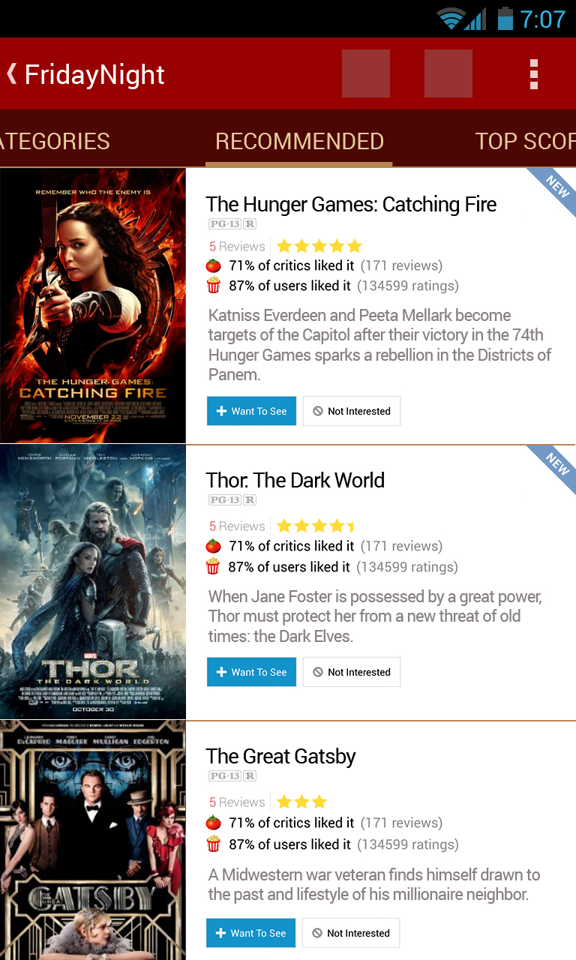
DEMO

Slide 10
TECHNICAL CHALLENGES
Notes:
Creating custom themes

Slide 11
TECHNICAL CHALLENGES
Getting API keys for Netflix and IMDB
Creating custom theme
Dealing with different APIs and data sets

Slide 12
WHAT’S NEXT?
Notes:
Support for newer APIs

Slide 13
WHAT’S NEXT?
Getting Netflix API key and adding support
Adding support for IMDB ratings
Support for Amazon Instant Video
Support for HBO GO
Releasing to the Google Play store

